Slide 1
Chapter 6
Interaction Analysis and Control System Configuration
Process Control
Dr. Cai Wenjian

Slide 2
Chapter 6 - Outline
Fundamental Concepts
  Measure of Control Loop Interactions
  Dynamic Relative Gain Array
  Interaction Analysis Based on Steady State Information
  Interpreting the RGA Elements and loop pairing rules
Semi-dynamic Loop Pairing - Time Domain Loop Pairing
  Control Structure Configuration - Interaction Index
Performance Limitations in Fixed Control Structure
  Decentralized Control and Closed-loop Interaction
  Performance Limitations in General Control Structure
Equivalent Transfer Function
  Equivalent Transfer Function Based on RNGA Approximation
  Open-loop and closed-loop transfer function relations
Process Control
Dr. Cai Wenjian

Slide 3
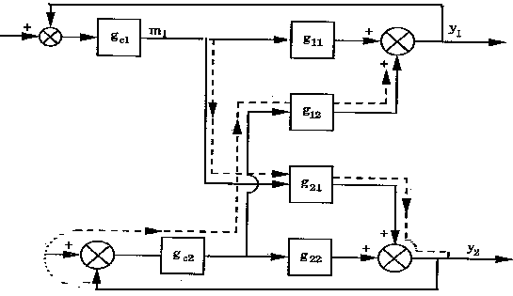
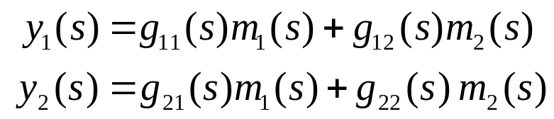
Interaction Measure of Control Loops
One manipulated variable affects more than one controlled variable
transfer function matrix - non-diagonal structure
2×2 system
Transmission interaction: exists when change in one controller set point affects output through the actions of other controller(s)
Process Control
Dr. Cai Wenjian

Slide 4
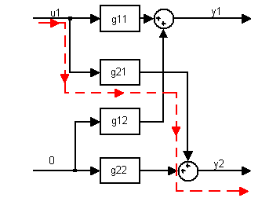
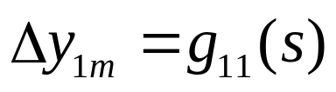
Interaction Measure: Experiment 1
Unit step change in u₁ with all loops open
Both y₁ and y₂ change,
Change in y₁ Δy_{1m}
As no other input variable change, and all the control loops are opened, there is no feedback control involved.
Process Control
Dr. Cai Wenjian

Slide 5
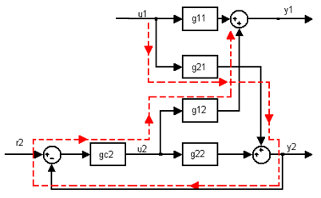
Interaction Measure: Experiment 2
Unit step change in u₁ with Loop 2 closed
Due to the change in u_{1:}
y₁ changes because of g₁₁, and y₂ change because g₂₁,
Loop 2 manipulating u₂ until y₂ is restored to its initial state.
3. The changes in u₂ return to affect y₁ via the g₁₂ .
Changes in y₁ from two sources
Direct influence of u₁ on y₁ ; Δy_{1m}
The retaliatory action from Loop 2 counter u₁ on y₂ say, Δy_{1r}.
Process Control
Dr. Cai Wenjian

Slide 6

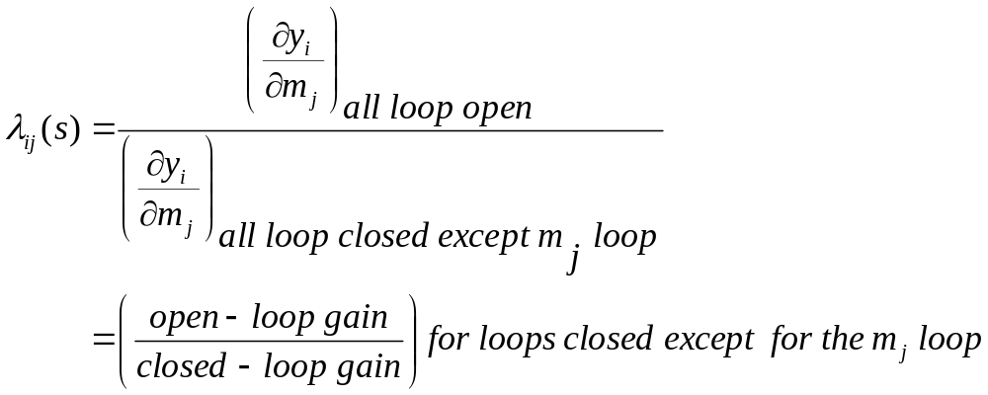
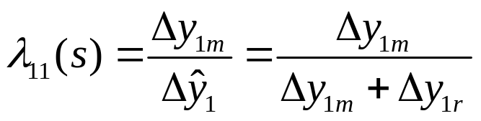
Dynamic Relative Gain
Closed-Loop: The net change in y₁, Δy₁*
Relative gain - ratio of gain with other loops open to other loops closed:
Example
Process Control
Dr. Cai Wenjian

Slide 7
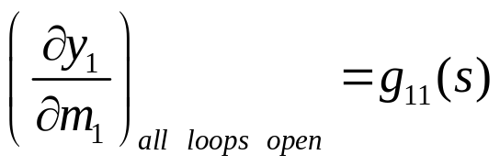

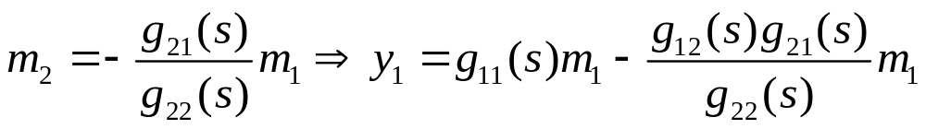
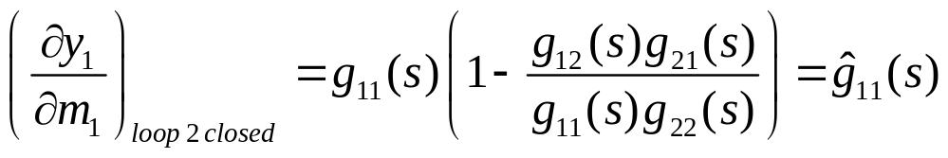
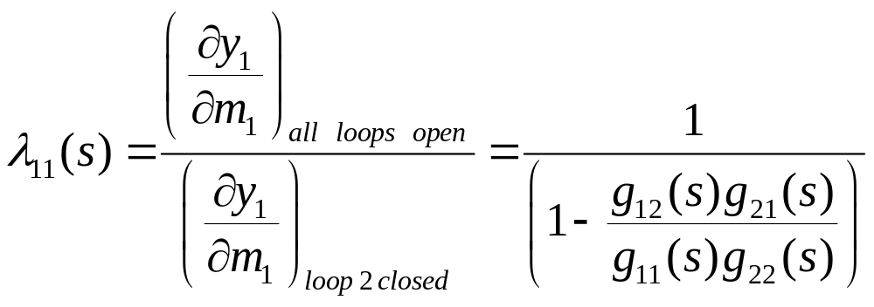
DRGA Calculation by Principle
2 × 2 model:
Loop 2 open
Loop 2 closed, y₂ = 0 in changes in m_{1;}
Process Control
Dr. Cai Wenjian

Slide 8
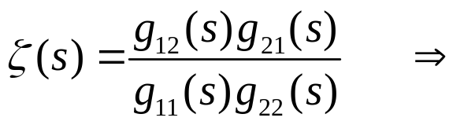
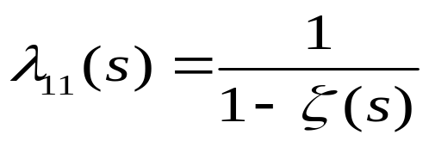
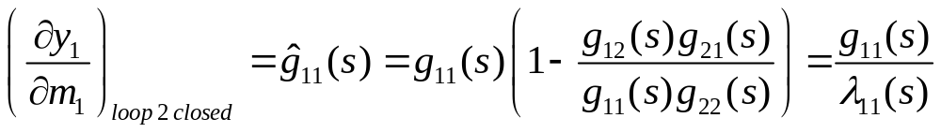
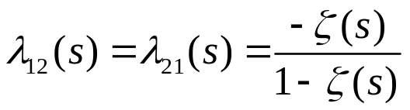
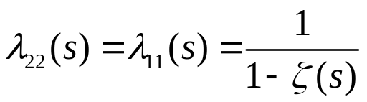
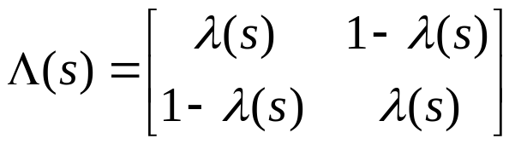
DRGA Calculation by Principle
Let
RGA for the 2 ×2 system :
Process Control
Dr. Cai Wenjian

Slide 9




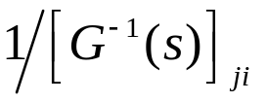


DRGA Calculation by Matrix Method
the gain from
to
is
DRGA matrix, thus, can be computed using the formula
The inverse
may be non-proper or non-causal.
  Perfect control is no meaning except at steady-state.
  Restricted applications to plants with no RHP-zeros.
Process Control
Dr. Cai Wenjian

Slide 10

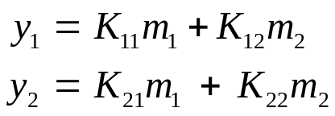
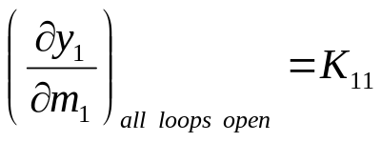

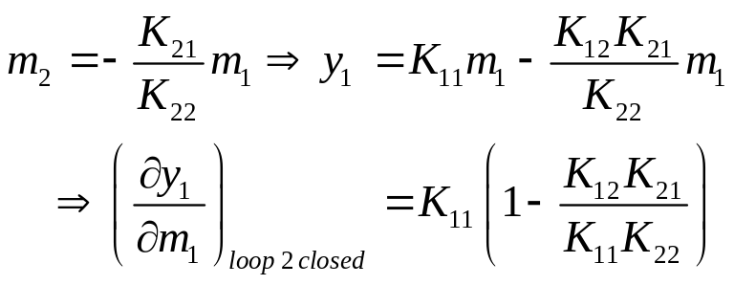

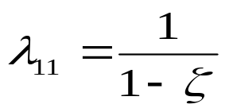
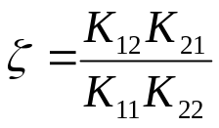


Steady State RGA
To relax restrictions, consider steady state
First-principles method
Matrix operation
K : steady-state gain matrix of G(s)
R: transpose of the inverse of K:
with:
Process Control
Dr. Cai Wenjian

Slide 11
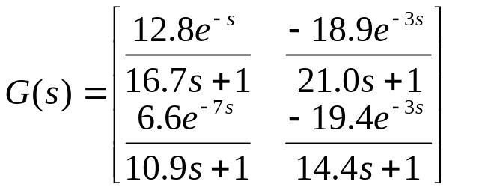
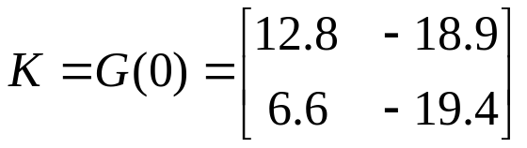
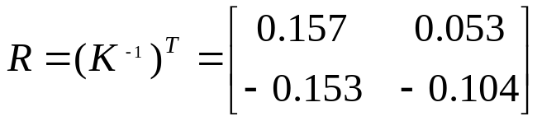
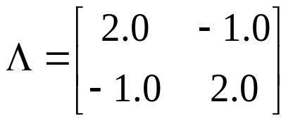
RGA Calculation Example
RGA: wood and binary distillation column
term-by-term multiplication of K_{ij} and r_{ij} gives the RGA as:
Process Control
Dr. Cai Wenjian

Slide 12
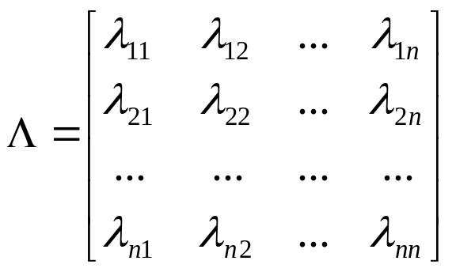
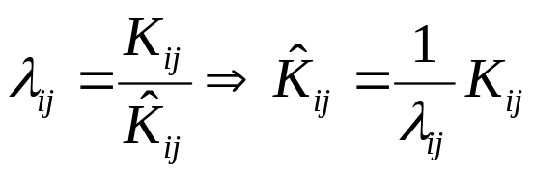
Properties of the RGA
Scale-independent - from definition
Row or column elements sum to 1
May be sensitive to errors in gain - careful using empirical transfer functions
Closed-loop steady-state gain and open-loop gain
Negative relative gain for i-j:
  opposite in sign for other loops are open and closed.
  Input/output pairings are potentially unstable and be avoided.
Process Control
Dr. Cai Wenjian

Slide 13
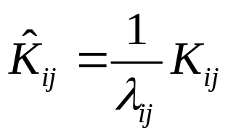






Interpretation of the RGA
Look at both sign and magnitude
Gain reversal occurs when other loops are closed - undesirable
  instability due to incorrect controller action
Open loop gain is zero, control action depends on other control loops being closed – not select
Gain amplification - loop gain increased if other loops are closed
No interaction: open-loop gain unaffected by other loops
  desirable - one-way interaction still possible
Attenuation of open-loop gain when other loops are closed
Loss of control when other loops are closed - gain goes to zero
  undesirable
Process Control
Dr. Cai Wenjian

Slide 14
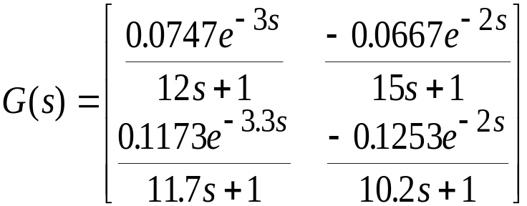

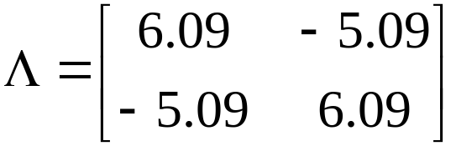
RGA Interpretation - Distillation Example
Pairing - use u₁-y₁ and u₂-y₂ loops
  avoid negative relative gains
Process Control
Dr. Cai Wenjian

Slide 15
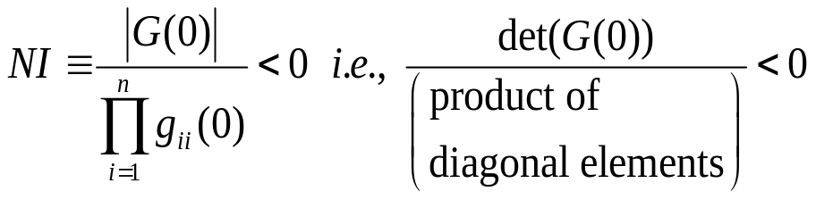
The Niederlinski Criterion
Test instability based on steady-state information
Arrange transfer function matrix: pairings are on diagonal
Stable - process elements must be open-loop stable
Proper - order of denominator greater than order of numerator
Individual control loops are closed-loop stable
Closed-loop unstable, if
Sufficient condition: if condition not satisfied, no instability detected --> this does NOT imply stability
use as a screening tool - identify problem cases
Process Control
Dr. Cai Wenjian

Slide 16
RGA and NI Based Pairing rules
Loop pairing Rules
RGA and NI based loop pairing rules requires that manipulated and controlled variables be paired:
Corresponding RGA elements are closest to 1.0.
Corresponding RGA elements are positive.
The NI is positive.
Large RGA elements should be avoided.
Process Control
Dr. Cai Wenjian

Slide 17
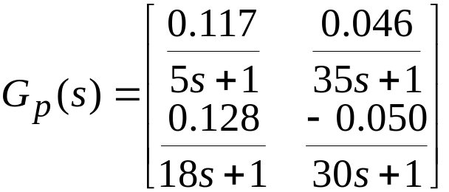
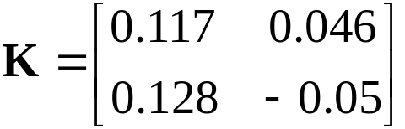
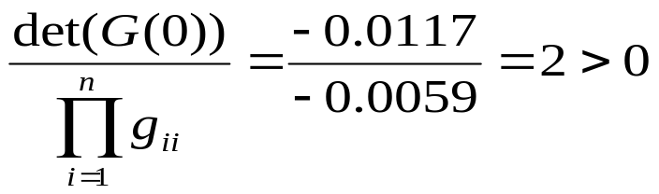
Example
Evaporator process for producing alumina:
relative gain is 0.5 for each pairing
- no preference indicated
re-arrangement of gain matrix isn’t necessary given 1-1, 2-2 pairing (paired transfer functions are on main diagonal)
Niederlinski test:
- instability is NOT detected
Note - no time delays, assuming integral control, proper transfer functions, open-loop stable
Process Control
Dr. Cai Wenjian

Slide 18
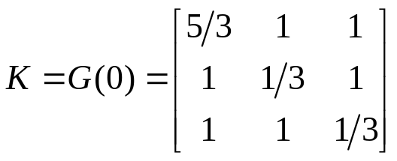
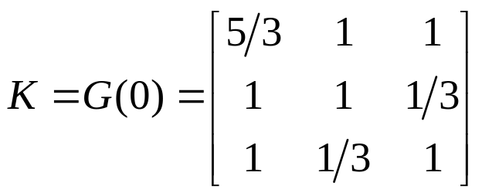
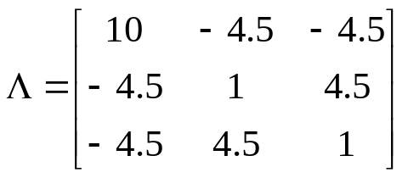
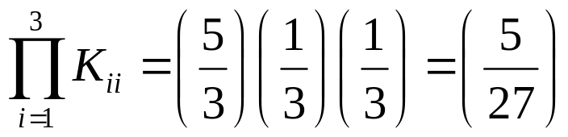
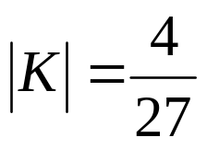
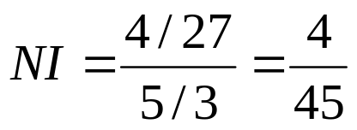


Loop pairing for a 3 × 3 system
Select 1-1/2-3/3-2
By RGA, 1-1/2-2/3-3 pairing, but
Notice the change of K
System stable
It is an unstable configuration
Process Control
Dr. Cai Wenjian

Slide 19
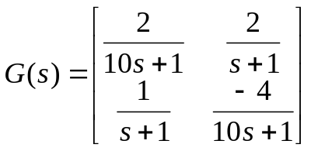
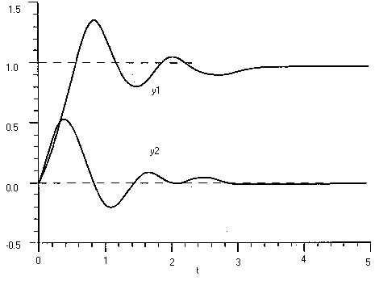
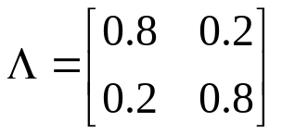
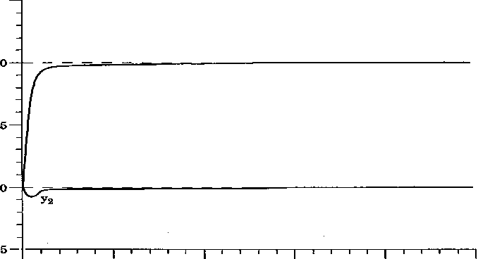
Timescale Decoupling
Dynamics of some loops very fast
fast loop responds so fast, effect of slow loop appears as a constant disturbance;
slow loop does not respond at all to high-frequency disturbances coming from fast loop.
Pair loops with fast dynamic, even when the RGA not favorable.
RGA: y₁ — m₁ / y₂ — m₂
unit step change in y₁ using the pairing and controller
Reverse Pairing:
Process Control
Dr. Cai Wenjian

Slide 20

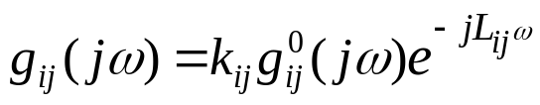
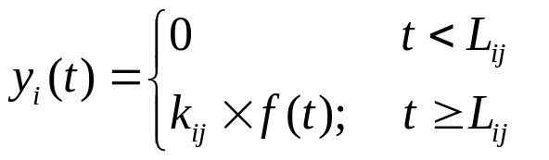


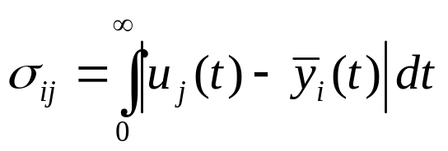
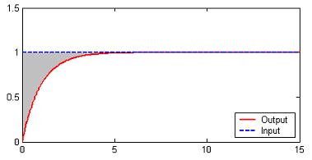






Normalized IAE (NIAE)
Steady-state gain
The transient function
Normalized IAE (NIAE), let
Normalized gain for
the larger of
the more effective of
to the output
will be
Process Control
Dr. Cai Wenjian

Slide 21



Calculation of NIAE
FOPTD
Average Residence Time
Process Control
Dr. Cai Wenjian

Slide 22


Normalized Gain
Define normalized gain
Process Control
Dr. Cai Wenjian

Slide 23


Relative Normalized Gain Array
RNG
Process Control
Dr. Cai Wenjian

Slide 24
Loop Pairing Based on RNGA
RNGA and NI based loop pairing rules requires that manipulated and controlled variables be paired:
Corresponding RNGA elements are closest to 1.0.
Corresponding RGA elements are positive.
The NI is positive.
All paired RNGA elements are positive.
Large RNGA elements should be avoided.
Process Control
Dr. Cai Wenjian

Slide 25




Example
1-2/2-1/3-3 pairing for RNGA, but differ to RGA 1-3/2-2/3-1
Give a clear 1-2/2-1/3-3 pairing (NI = 0.2593 > 0)
Process Control
Dr. Cai Wenjian

Slide 26




Forms of Controls
Decentralized control:
Centralized control:
Sparse Control:
Process Control
Dr. Cai Wenjian

Slide 27
Main Couplings and Cross Couplings
Putting paired loop in diagonal
Main loop couplings y₁ — u₁ , y₂ — u₂,…, y_{n} — u_{n}, used for control
Cross-couplings, y_{i} — u_{j} (i ≠ j) undesirable; loop interactions
Eliminates the effect of undesired cross-couplings, improve control performance.
Compensate interactions if they are big
Multiloop (Decentralized) - use of several single-loop controllers (e.g., PID)
Multivariable (Decoupling, Sparse, Block Decoupling) - make control decisions jointly considering more than one output
For a given process, what kind of control is best?
Process Control
Dr. Cai Wenjian

Slide 28


Normalized Interaction Index
Put paired loops in diagonal position, define
Relative control performance index (RCPI),
= 0: centralized; ε = 1: decentralized controller
0<ε<1, smaller ε, better overall control system performance achievable, block diagonal controller or sparse controller would be preferred
if all off-diagonal elements less than 0.15, decentralized control can result in satisfactory performances.
If some off-diagonal elements close to 1, block diagonal controller or sparse controller would be preferred
Process Control
Dr. Cai Wenjian

Slide 29





Example
Process Control
Dr. Cai Wenjian

Slide 30






Relative Average Residence Time
Define relative average residence time (RART)
By RNG
Since
then
RART
Process Control
Dr. Cai Wenjian

Slide 31


ETF Based on RNGA Approximation
Assigning the Equivalent Transfer Function (ETF) when other loops are closed to have the same structures as the open-loop transfer functions,
By relative gains and relative average resident times
ETFs when the control system is closed can be approximated as:
Process Control
Dr. Cai Wenjian

Slide 32










Example
Process Control
Dr. Cai Wenjian

Slide 33


Open Loop and Closed Loop Relation
By definition of dRGA
Using ETFs
Process Control
Dr. Cai Wenjian

Slide 34


Closed Loop ETF
By assuming perfect control and matrix calculation
Compare the Two, Important Relation
Process Control
Dr. Cai Wenjian

Slide 35










Example
Process Control
Dr. Cai Wenjian

Slide 36





Function Definition
Closed-loop transfer function
Sensitivity function
Complementary sensitivity functions
Closed loop transfer function
Process Control
Dr. Cai Wenjian

Slide 37






Control Objective
For good control, the forward transfer function
such complementary sensitivity function:
Since
there has the relation:
Now the design target is to find
such that for perfect control:
Process Control
Dr. Cai Wenjian

Slide 38




Minimization Problem
Since
Rewrite
Define an objective function:
Minimization requires
Multivariabl Process Control
Prof. Cai Wenjian

Slide 39




Parameterization
determined
Gain and phase margin design
Ideally
Multivariabl Process Control
Prof. Cai Wenjian

